Slide 1


Fundamentals of RM
RM System and Process
Leadership in RM
Incident Investigation
RM Tools & Challenges
RM in Industry
People & Org.
Application and Perspectives
On Becoming a
Leader in Risk Management
ENGG404 - Lecture
Chapter 7.4:
The Importance of Culture &
Making Everyone a Leader in Safety

Slide 2
Learning Outcomes:
Explain the “Three Tenets of Risk Management”.
Explain the “The Incident Pyramid” and the relationship between its layers, and that its set of ratios is not an absolute.
Explain the concept that performance is based on safety culture.
Infer the safety culture of an organization based on its metrics.
Demonstrate how everyone can be a leader in safety and risk management.
Chapter 7.4: Importance of Culture & Making Everyone a Leader in Safety
2
Notes:
2

Slide 3
Three Tenets of Risk Management:
Incidents occur, and are regularly reported in the media.
These losses cannot be denied nor diminished.
Incidents are a source of learning, but this is a hard way to learn.
Incidents are a tragedy, but the greater tragedy would be NOT to learn from them.
All incidents are unacceptable and all are preventable!
Our position and stature as a leader require us to
espouse this belief, and diligently work towards
preventing all incidents.
These tenets, our beliefs as leaders in risk management, are the base on which we create our values and how we influence the culture of our organizations.
Chapter 7.4: Importance of Culture & Making Everyone a Leader in Safety
3
Notes:
3

Slide 4
ALE #1: Three Tenets of Risk Management:
Please confer and respond (pen-to-paper, Open discussion):
Concerning the third tenet “All incidents are unacceptable and all are preventable!”, challenge the belief that “all incidents are preventable” and support with an argument using either a principle or an example.
Phrase your response either as “Some incidents cannot be prevented because …” or “Some incidents cannot be prevented such as …”.
Chapter 7.4: Importance of Culture & Making Everyone a Leader in Safety
4
Notes:
4
This question challenges students to critique the tenet that “all loss incidents are preventable”. The instructor will need to be on the ball to defend the tenet.

Slide 5
The Incident Pyramid, per Frank Bird, ILCI:
The Incident Pyramid depicts the performance of the organization.
Bird, Frank E., and Loftus, Robert G., Loss Control Management,
International Loss Control Institute, 1976.
For our purposes, use the ratios (1 : 10 : 30 : 600 : 10,000) as shown above.
Chapter 7.4: Importance of Culture & Making Everyone a Leader in Safety
5
Notes:
5

Slide 6
Incidents with Consequence vs. Incidents with No Consequence:
Chapter 7.4: Importance of Culture & Making Everyone a Leader in Safety
6
Notes:
6

Slide 7
The Shape of the Incident Pyramid:
Ratios vary widely because:
the degree of observations and self-reporting on substandard conditions and substandard practices;
the extent of reporting incidents such as near miss incidents
(close calls);
the extent of reporting minor incidents;
the extent of reporting major incidents.
The “culture” of the company defines what is reported:
Leading organizations focus on both actual and potential consequences of incidents.
Inferior companies only report what is required by law e.g. fatalities, major fires.
Chapter 7.4: Importance of Culture & Making Everyone a Leader in Safety
7
Notes:
7

Slide 8
Proactive Action versus Reactive Response:
Chapter 7.4: Importance of Culture & Making Everyone a Leader in Safety
8
Notes:
8

Slide 9
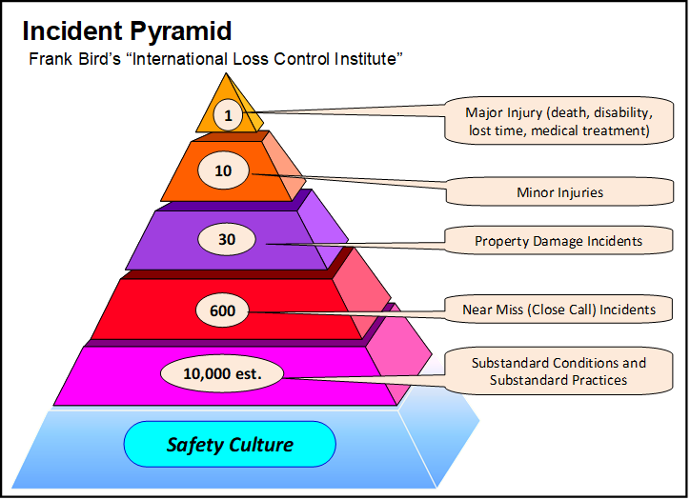
The Incident Pyramid and Safety Culture:
Notice the underlying foundation of The Incident Pyramid:
An adaptation of Bird, Frank E., and Loftus, Robert G., Loss Control Management, International Loss Control Institute, 1976.
Chapter 7.4: Importance of Culture & Making Everyone a Leader in Safety
9
Notes:
9

Slide 10
ALE #2: Relationship Between Safety Culture & Performance:
Please confer and respond (pen-to-paper; open discussion):
How does safety culture impact safety performance? What is the direct relationship between safety culture and safety performance? Phrase your response as “Performance improves as … because …”.
Relationship between safety culture & performance?
Chapter 7.4: Importance of Culture & Making Everyone a Leader in Safety
10
Notes:
10

Slide 11
Relationship Between Safety Culture and Performance:
If you have a safety culture that addresses sub-standard conditions and sub-standard practices, it reduces the number of near misses, incidents, and injuries up the pyramid i.e. performance improves.
Chapter 7.4: Importance of Culture & Making Everyone a Leader in Safety
11
Notes:
11

Slide 12
Relationship Between Safety Culture and Performance:
Further, by promoting and building a strong safety culture, leaders have a significant influence on workplace safety performance.
Chapter 7.4: Importance of Culture & Making Everyone a Leader in Safety
12
Notes:
12

Slide 13
Making Everyone a Leader in Safety & Risk Management:
Leaders can empower their employees to address SC’s and SP’s, and engage employees in incident investigations; thus developing and strengthening the desired culture!
Chapter 7.4: Importance of Culture & Making Everyone a Leader in Safety
13
Notes:
13

Slide 14
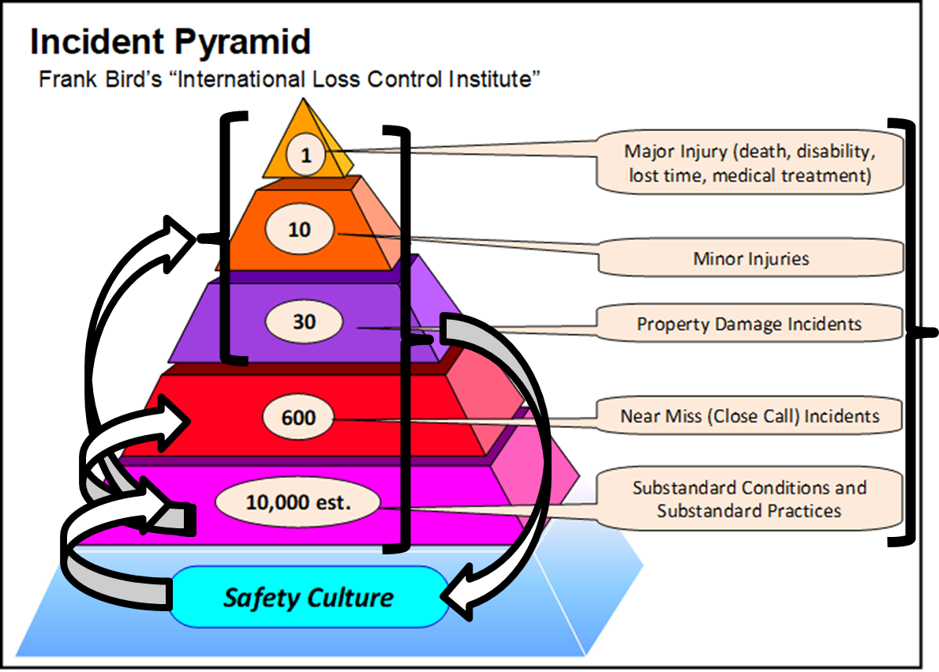
Summary and Key Lessons:
Three Tenets of Risk Management:
  Incidents occur.
  Incidents are a hard way to learn.
  All incidents are unacceptable and all are preventable!
Safety Culture directly
affects Safety Performance.
Leaders can influence
Safety Culture by addressing
SC’s, SP’s, NM’s, LI’s, and
coaching and engaging
employees in resolving these.
Chapter 7.4: Importance of Culture & Making Everyone a Leader in Safety
14
Notes:
14

Slide 15
Any questions?
Notes:
15

